Slide 1
Capstone Engagement
Assessment, Analysis, and Hardening of a Vulnerable System

Slide 2
Table of Contents
This document contains the following sections:
01
Network Topology
02
Red Team: Security Assessment
03
Blue Team: Log Analysis and Attack Characterization
Hardening: Proposed Alarms and Mitigation Strategies
04

Slide 3
Network Topology
‹#›

Slide 4
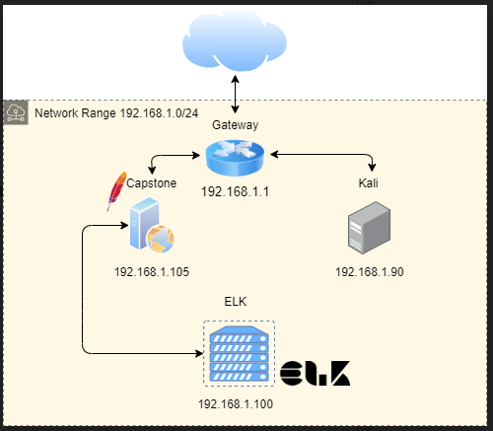
Network Topology
Network
Address Range: 192.168.1.0/24
Netmask: 255.255.255.0
Gateway: 192.168.1.1
Machines
IPv4: 192.168.1.90
OS: Linux
Hostname: Kali
IPv4: 192.168.1.105
OS: Apache
Hostname: Capstone
IPv4: 192.168.1.100
OS: Linux
Hostname: ELK

Slide 5

Red Team
Security Assessment
‹#›

Slide 6
Recon: Describing the Target
Nmap identified the following hosts on the network:
Hostname | IP Address | Role on Network
Gateway | 192.168.1.1 | Communicates between the internet and the devices connected to our network and routes traffic to the hosts.
Kali | 192.168.1.90 | The system we will use for network scanning, penetration testing, and security auditing.
Capstone | 192.168.1.105 | The web server that will be handling HTTP requests and web resources.
ELK | 192.168.1.100 | Server with Elasticsearch, Logstash, & Kibana used for monitoring logs and providing network analytics.

Slide 7
Vulnerability Assessment
The assessment uncovered the following critical vulnerabilities in the target:
Vulnerability | Description | Impact
Security Misconfigurations | Lack of authorization protocols for restricted directories allowed forced browsing. Multiple other security misconfigurations exist as well. | This was the first stepping stone for our attack. Running dirb provided details on the hidden /webdav directory.
Brute Force Login Vulnerability | Unrestricted login attempts resulted in brute force login. Unlocked Ashton’s password with Hydra. | Accessed secret folder which contained sensitive instructions for accessing the server through WebDAV.
PHP Reverse Shell Vulnerability | Established shell connection through a reverse php payload. | Successfully established meterpreter session, traversed network, captured the flag.

Slide 8
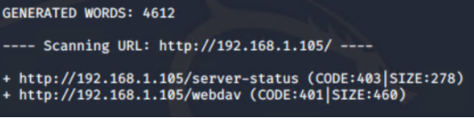
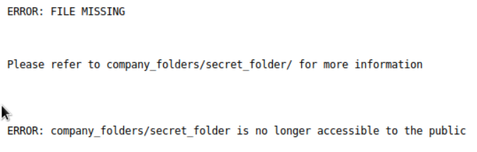
Exploitation: Security Misconfigurations
01
02
03
Tools & Processes
Used nmap to map the network, discover IPs and open ports, and scan for running services.
Executed dirb to enumerate the hidden webdav directory.
Utilized browser to navigate folders on the web server.
Achievements
Exposed the hidden webdav directory which revealed more clues. This was the entry for our attack.
Discovered the existence of a secret_folder directory within the company_folders directory.
Browsed the network.

Slide 9
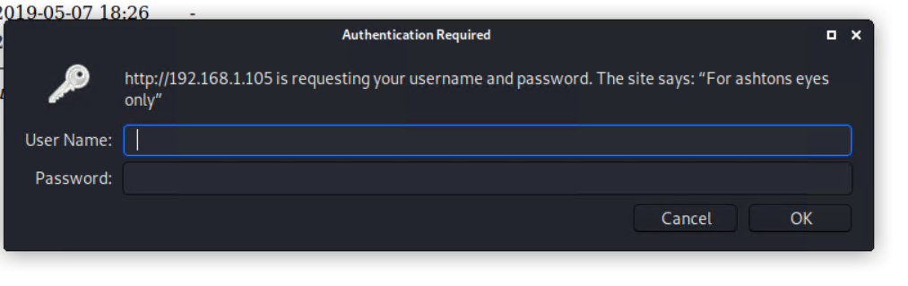
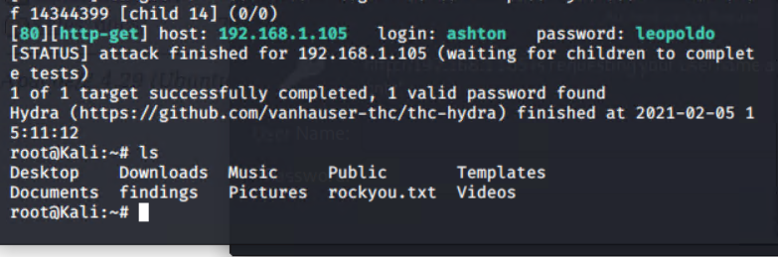
Exploitation: Brute-Force Login Vulnerability
01
02
03
Tools & Processes
Used Hydra to brute-force the password for Ashton’s account with the username ashton.
Utilized Crack Station to crack Ryan’s password.
Achievements
Logged in to Ashton’s account and gathered instructions on how to access the corporate server.
Uncovered a password hash for Ryan’s password.
Cracked Ryan’s password.

Slide 10
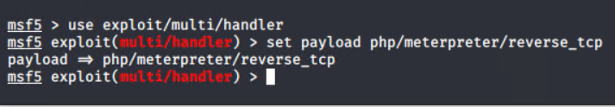
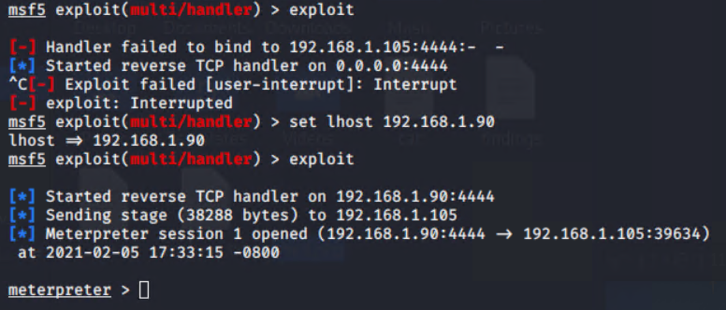
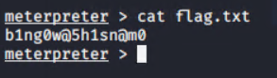
Exploitation: PHP Reverse Shell Vulnerability
01
02
03
Tools & Processes
Utilized msfvenom to upload the reverse shell payload.
Used metasploit from the command line to find a reverse PHP shell vulnerability we could use on the target.
Achievements
Successfully deployed the reverse shell payload and established a meterpreter session.
Traversed the directories of the Capstone server and captured the flag.

Slide 11

Blue Team
Log Analysis and Attack Characterization
‹#›

Slide 12
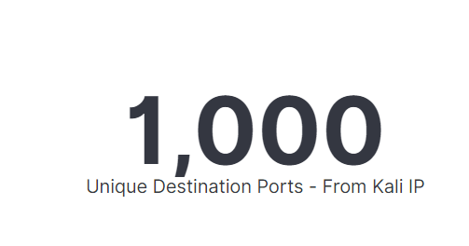
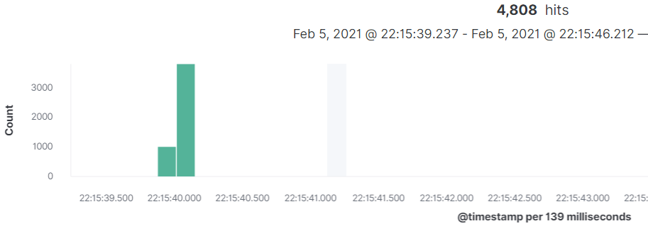
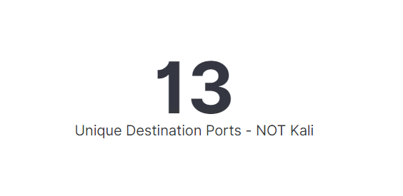
Analysis: Identifying the Port Scan
The port scan occurred February 5th at approximately 22:15.
We received 4,808 hits and 8,701 packets in total from ip 192.168.1.90 (Kali) at 22:15 until 22:17.
Over 1,000 unique destination ports were requested via these hits.
During this same time period, only 13 unique destination ports were requested from all other IP addresses combined.

Slide 13
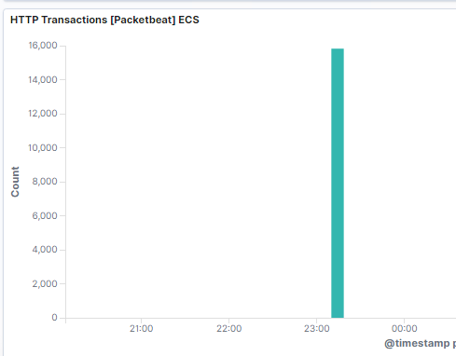
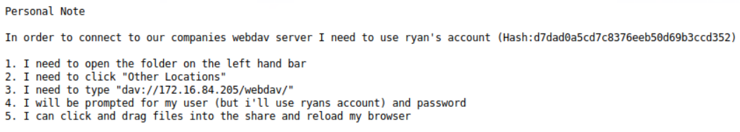
Analysis: Finding the Request for the Hidden Directory
At 23:10, 15,826 requests were made to access /company_folders/secret_folder from the Kali IP address.
The file requested was connect_to_corp_server. This file contains sensitive information including instructions for accessing the corporate server as well as Ryan’s password hash.

Slide 14
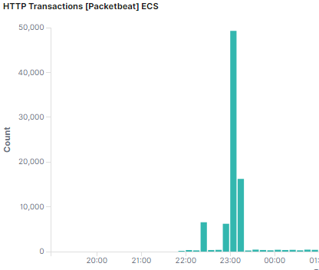
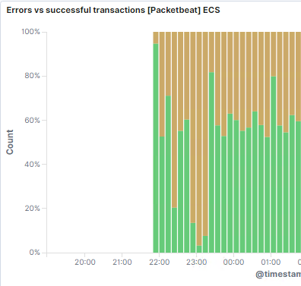
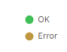
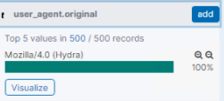
Analysis: Uncovering the Brute Force Attack
At 23:01, the brute force attack occurred as evidenced by the spike in HTTP transactions and the corresponding spike in errors.
Of the 50,000+ HTTP transactions that occurred at this time, we uncovered 6,035 attempts (GET requests) to login to the webdav directory before the attacker discovered the correct password. Further analysis showed the user agent Mozilla/4.0(Hydra) assigned to 100% of these attempts.

Slide 15
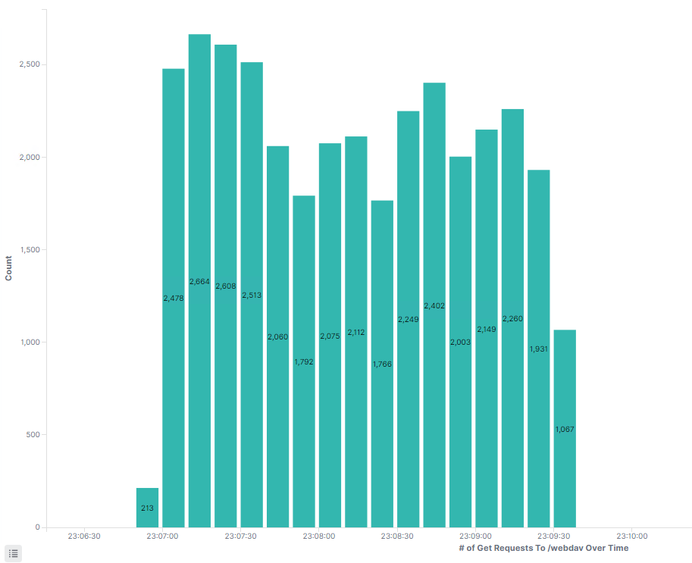
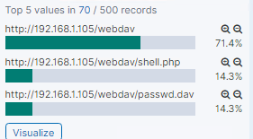
Analysis: Finding the WebDAV Connection
In total 34,342 attempts were made to the webdav directory in total from the Kali IP before successful access.
We found two hits at 23:16:55 that successfully accessed passwd.dav. Also, two hits were discovered at 01:01:15 on February 6th indicating a file called shell.php was accessed. Two hits from a PUT request request to shell.php were discovered at 00:58:57.

Slide 16
Blue Team
Proposed Alarms and Mitigation Strategies
‹#›

Slide 17

Mitigation: Blocking the Port Scan
Utilize IDS such as Security Onion to monitor the network and Snort to trigger alerts in the event future port scans are detected.
Implement Snort rule to alert and/or block traffic going to ports greater than or equal to 500:
alert tcp any :1024 -> 192.168.1.0/24 500:
Configure firewall on this network as currently none exists.
Start with UFW, move to firewalld eventually to avoid service disruptions.
Example: adding rules to allow http and/or https and ssh only as root user:
ufw deny incoming
ufw allow 80
ufw allow 22
ufw allow 443

Slide 18
Mitigation: Finding the Request for the Hidden Directory
Utilize Security Onion and configure Snort rule for triggering an alert when a threshold of 5 connections come from a single source over 30 seconds.
Set snort rule to block any requests to this directory from any non-authenticated user.
Encrypt the /secret_folder so it is only readable with the encryption key.
Move the directory to a separate data server only accessible by SSH.
Set user permission levels so that regular users cannot browse the network.
Remove any content on web server that hints at the existence of this directory.

Slide 19
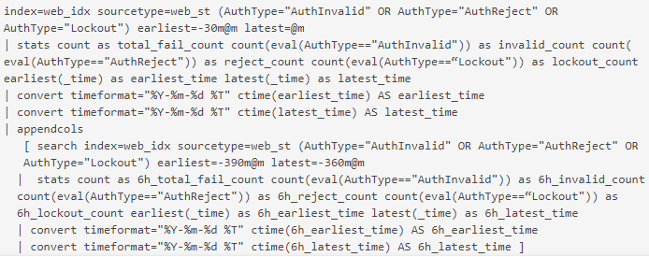
Mitigation: Preventing Brute Force Attacks
Utilize splunk to manage brute force alerts.
Create an alert when splunk detects increase in various brute force stats of the last 30 minutes compared to a 30 minute period 6 hours earlier: e.g.
Temporary account lockout if max login threshold reached to prevent complete denial of service.
Utilize device cookies to distinguish between known and unknown clients. This will slow an attack.
Use multi-factor authentication and CAPTCHA to slow down and hopefully discourage an attack.
Utilize secure password protocols including number of characters, alphanumeric, and special characters.
What configuration can be set on the host to block brute force attacks?
Password protocols, lock account after XX # of failed logins, or at the very least lock account for XX time after XX # of failed login attempts.
Must balance protection mechanisms with d.o.s. prevention!
Limit failed logins, MFI, Captcha,
https://owasp.org/www-community/Slow_Down_Online_Guessing_Attacks_with_Device_Cookies
Describe the solution. If possible, provide the required command line(s).

Slide 20
Mitigation: Detecting the WebDAV Connection
Whitelist IP addresses that can access WebDAV and block all others.
Set a splunk alert to notify the admin of any traffic to WebDAV from any IP not whitelisted.
Set a splunk alert to notify the admin in the event of 3 failed attempts to access the WebDAV directory over 10 minutes.
Recommend switching the site to HTTPS protocol instead of HTTP to ensure valid SSL certificates.
Block access from any IP address not whitelisted.
Utilize File Lock features within WebDAV to secure certain files and directories and to prevent multiple users from editing the same file simultaneously.

Slide 21
Mitigation: Identifying Reverse Shell Uploads
Create splunk alert for any unauthorized file upload.
Set threshold to 1 so it will alert of any attempt.
Alternatively, set an alert to trigger based on certain file types (.php).
Custom splunk alerts can be configured within splunk’s alert_actions.conf file.
Require user authentication in order to upload files.
Store uploaded files in a location not accessible from the web.
Scramble uploaded file names and extensions.
Define valid types of files that the users should be able to upload.

